Slide 1
Other Upcoming Events
Next Assembly Meeting—Regental Candidates Forum, Mon October 24
CIC Big10 Academic Alliance Gov. Leadership Conf. 9/28-30, Lansing
Rollout of DEI Plan
Academic Innovation Initiative Kickoff 2-5p Th Sept 29, Alumni Ctr
(SACUA is seeking volunteers!)
President’s Leadership Breakfast, Oct 5

Slide 2
SA Committee Memberships
These are your committees nominated by SACUA.
We asked EOs for nominations in the spirit of Shared Governance
All nominated members are on SACUA web site
RSG/CSG have cooperated better to fill (still vacant) student slots
CCRL in hiatus
Inactive last year
GCAC was covering same topics
Against judgement of both chairs and Tim Lynch
CERAC held together for one more year (possible subcommittees)

Slide 3
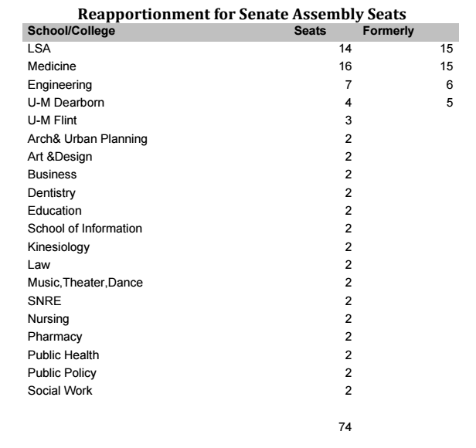

Slide 4
Faculty Governance 101
Instructor: Prof. William W. Schultz
Tel: 6-5001
Email: facultysenatechair@umich.edu
Office hrs: as required, 6th floor Fleming
Prerequisite: none
Prepares for: Faculty Governance 102
Required text: https://facultysenate.umich.edu/
Grading
Quizzes Daily
Usually only 2 possible answers
Usually no “right” answers
Hence, we grade on curve
Attendance and classroom participation: very important
Today’s “quiz” is meant to take the temperature of the Assembly,
Is non-binding, and will help prioritize future discussions.

Slide 5
Three Branches of Government

Slide 6
The fine print: What’s in a title (FS-wise)?
Titles are like key chains, usually the smaller the better
President
Assistant to the Associate Vice President
Prepositional phrases don’t count (usually)
Nouns: Professor, Instructor, Scientist, Dean, Officer, Librarian
Adjectives: Associate, Assistant, Research, Clinical, Distinguished, Executive, Adjunct, Emeritus
Q1: Should we consider changing color of Clinical?
Q2: Should we consider changing color of Emeritus?
Q3: Should we consider adding Lecturer IV to the Senate?

Slide 7
Venn Diagrams
USG UMFG
Senate
Senate Assy
Not to scale
Legislative
Judiciary
Too simplified
SACUA
Executive
SACUA
WWS
SA Comm
Why do we need Assembly?
Rep. Gov., Resolutions, Choose SACUA
Why do we need Senate?
1/year, Elect Secretary, Grassroots Appeal
Q4: Should we consider growing assembly?
Q5: Should we consider email voting, especially for Senate?

Slide 8
Venn Diagrams (Cont) 3 Campus FG
Assembly is formal part
AA larger campus, higher % TTF
Flint has no Senate
Dearborn has no Adv Comms
Pres. Schlissel has admin control
VPs not so clear
SACUA often FG of last resort
Flint
AA
D’born
Q6: Should we consider guaranteed Flint/Dearborn member of SACUA?

Slide 9
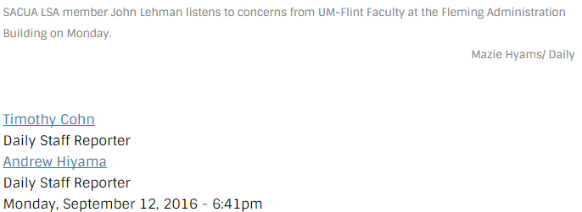
Effective Fac Gov comes from
Publication of Agenda/Minutes
Frank discussions with EOs
Being responsive to constituents
Welcoming visitors
Sunshine of press coverage
whenever possible.
Q7: Should we consider more
extensive use of Exec Session
in Assembly?
Q8: Should we consider developing
a committee year-end summary that
would also sent to EO” supervisor”?

Slide 10
Issues
No explicit relationship
3 faculty handbooks
3 Provosts
Regents' Bylaws do not detail fac. governance structure for D/F
Vast increase in lecturers at D/F
Unclear derivative authority
cc: Gatesee - https://www.flickr.com/photos/17919943@N02

Slide 11
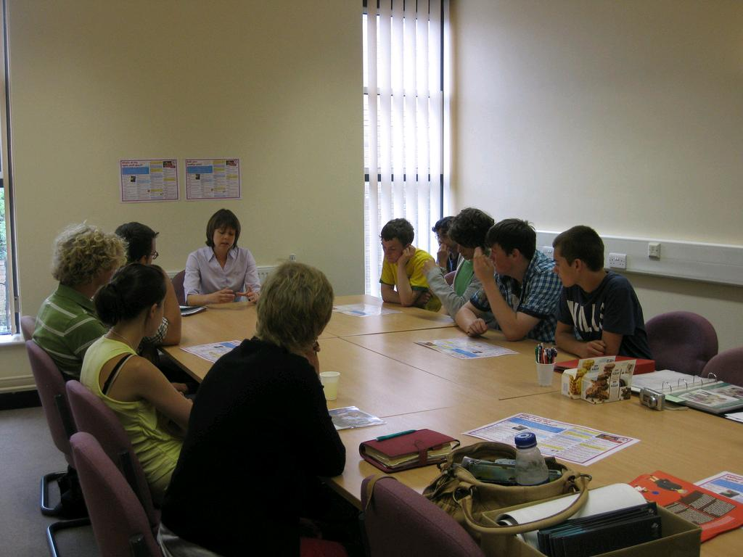
Recommendation
This body establish a task force to consider:
1. Relationship of faculty governance at D/F & the University Faculty Senate;
2. A core U-wide faculty handbook with discrete campus supplements;
3. Recommendations of ways & means to support & strengthen governance at D/F.
Q9: Should we consider forming a 3 Campus task force for UMFG coordination & support?
cc: National Assembly For Wales / Cynulliad Cymru - https://www.flickr.com/photos/39069511@N03

Slide 12
Tale of Two Cities
East Lansing
Senate:
control of the University curriculum
provides leadership in faculty policies, procedures, tenure, salaries/ compensation and faculty life
Faculty (& Student) Liaison Committee to the MSU Board of Trustees
“Non voting member”
Seat at table
Q10: Should we consider asking for a Faculty “seat at the table”?
Q11: Should we consider asking for equivalent voice to students?

Slide 13
Tale of Two Cities
Champaign/Urbana
Shared Governance Q12: Should we consider?
This Senate picked the chancellor search committee
Determines requirements for admission & degrees
200 faculty members/50 students/8 Academic Staff
Require training in Open Meetings Act
Have Parliamentarian Q13: Should we consider?
Stream/video archive of all meetings Q14: Should we consider?
Clickers Q15: Should we consider?

Slide 14
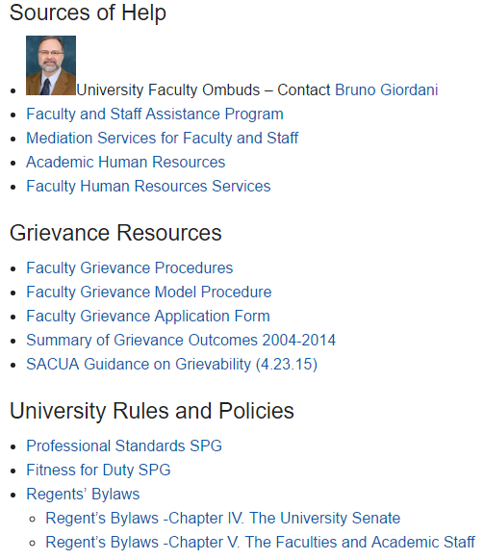
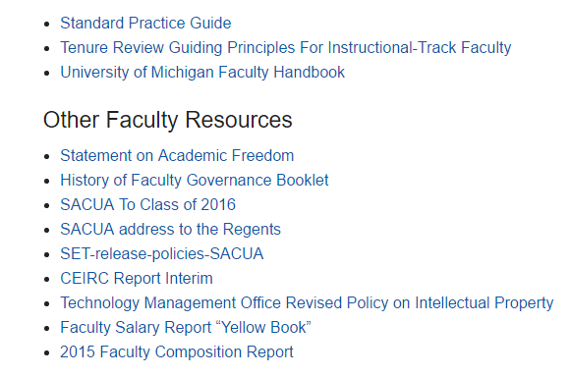
Q16: Should we consider chair-elect, past chair posts?
Q17: Should we consider guns in classrooms?
Q18: Should we consider gender in bathrooms?
Q19: Should we consider competing for AFL?
Q20: Essay: What did we miss?

Slide 15
Class dismissed
Thanks! Have a great semester!

