Slide 1
Medical Affairs Advisory Committee Meeting
Working toward Gender Equity in Medicine
what have we learned, what can we do better
Sowmya Balasubramanian MD, MSc
Clinical Associate Professor
Division of Pediatric Cardiology
November 17th, 2021
Email: sowmyab@med.umich.edu

Slide 2
Disclosures
None

Slide 3
Outline
Prevalence of gender disparities in academic medicine
  Current and temporal trends
Causes of sustained differences
  Gendered expectations
  Unconscious bias
  Gender harassment
Effects of the COVID pandemic
Interventions

Slide 4
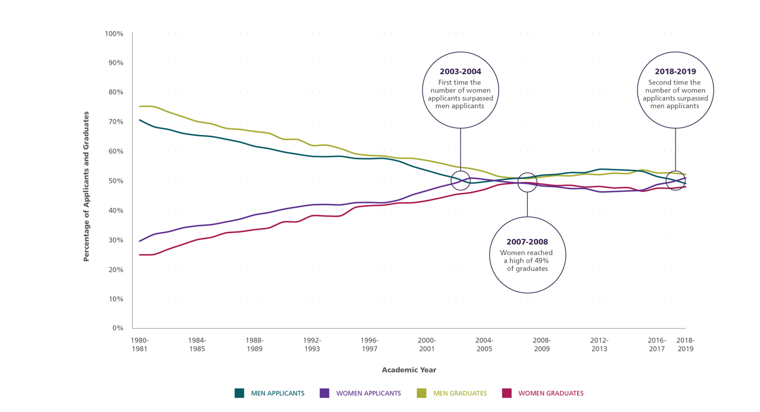
Temporal Trends of Medical Graduates
2003-2004
First time the number women applicants surpassed men applicants
2018-2019
Second time the number of women applicants surpassed men applicants
Percentage of Applicants and Graduates
2007-2008
Women reached high of 49% of graduates
https://www.aamc.org/data-reports/data/2018-2019-state-women-academic-medicine-exploring-pathways-equity
Notes:
Several research publications point to not only there being disparities, the rate at which improvements are being made are staggeringly low.

Slide 5
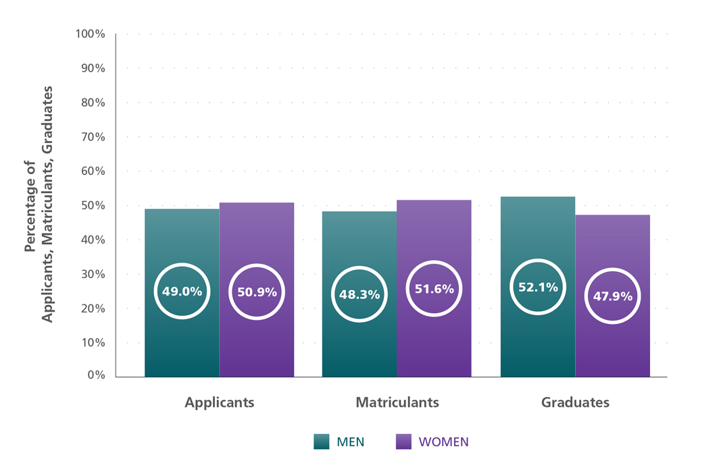
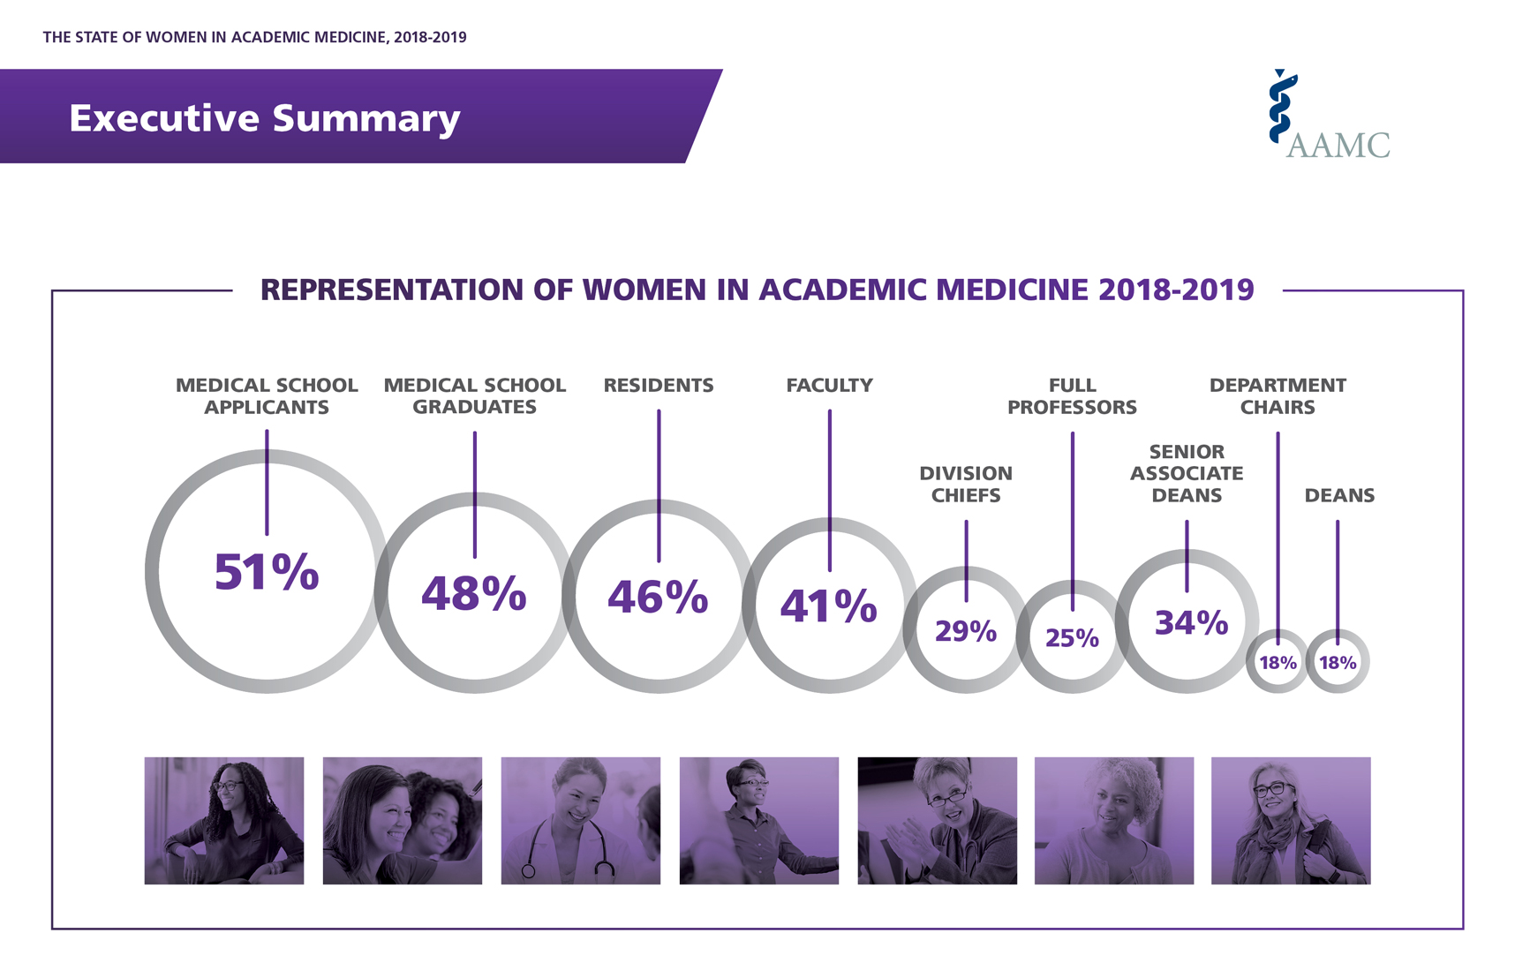
Current Landscape of Medical Graduates
Proportion of women from underrepresented group
12% in 2009, 13% in 2018
Greatest proportion of URiM women faculty at the assistant professor rank
https://www.aamc.org/data-reports/data/2018-2019-state-women-academic-medicine-exploring-pathways-equity
Notes:
The overall proportion of full-time women faculty has continued to rise since 2009, now at 41%, with similar increases at each faculty rank; yet, women make up a majority of faculty only at the instructor rank.

Slide 6
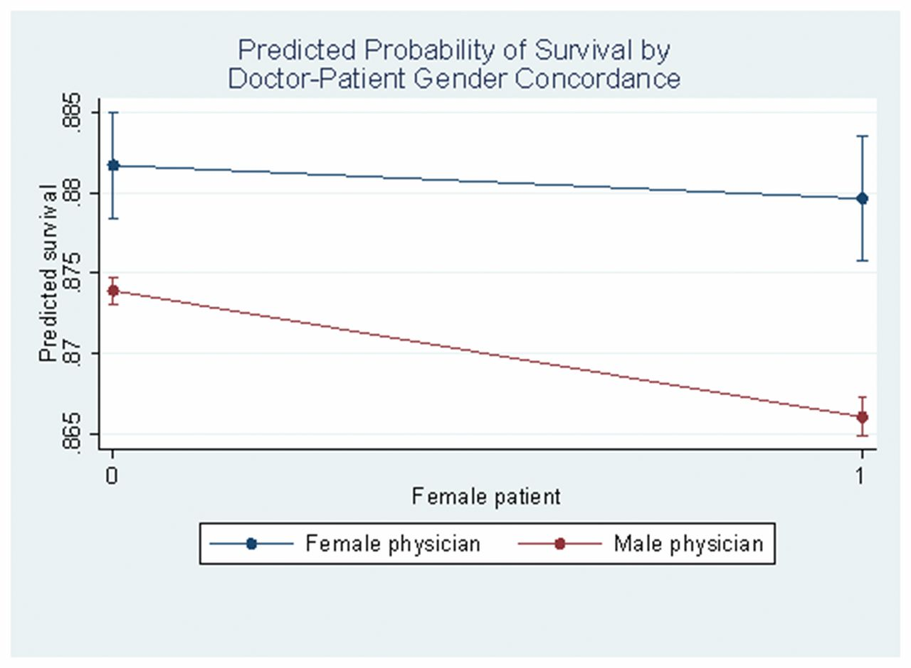
Why is diversity important?
Simply the right thing to do…
Serious stakes not only for women in the work force
  Effects extend beyond the targets of mistreatment
  Affects quality of research, teaching and clinical care
Impacts the field of medicine at large
  “diversity in human capital brings diversity in thought and leads to innovation, stronger teams and better outcomes for patient”
Notes:
In fact, the difference in patient mortality observed in studies of male and female physicians is approximately the same magnitude as the improvement in mortality that can be attributed to the last decade of scientific improvement in patient care.

Slide 7
Are numbers alone sufficient?
NEJM. 1989; 321(22): 1511
Survey study (70% response rate)
Increasing number of women medical graduates
Underrepresentation of women in leadership positions
Lack of role models
Academic Medicine. 2016; 91 (8): 1053
Notes:
Making progress on the numbers (gender diversity)
True progress in improving women’s sense of belonging / inclusions – lagging
The field is routinely under-promoting, under-supporting, under-rewarding, and under-training female physicians

Slide 8
Four key gate keepers
As a first step, lets examine data in the four important avenues for advancement
Medical Journals
Societies
Universities
Hospitals
Funding Agencies

Slide 9
S Balasubramanian, S Saberi, S Yu, CS Duvernoy, SM Day, PP Agarwal Circulation. 2020; 141: 603 - 605
Temporal Trends
General Cardiology Journals

Slide 10
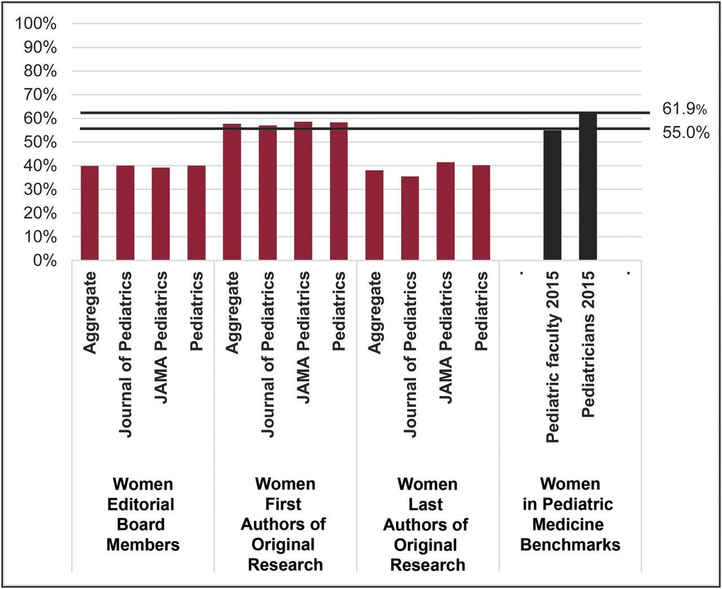
PEDIATRICS Volume 144, number 5, November 2019
For more than a decade, women have comprised more than
70% of pediatric residents
55% of pediatricians in practice
48% of full time faculty
27% full time professors

Slide 11
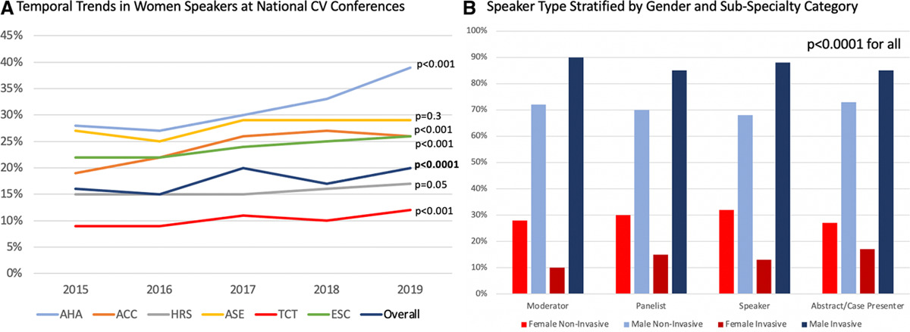
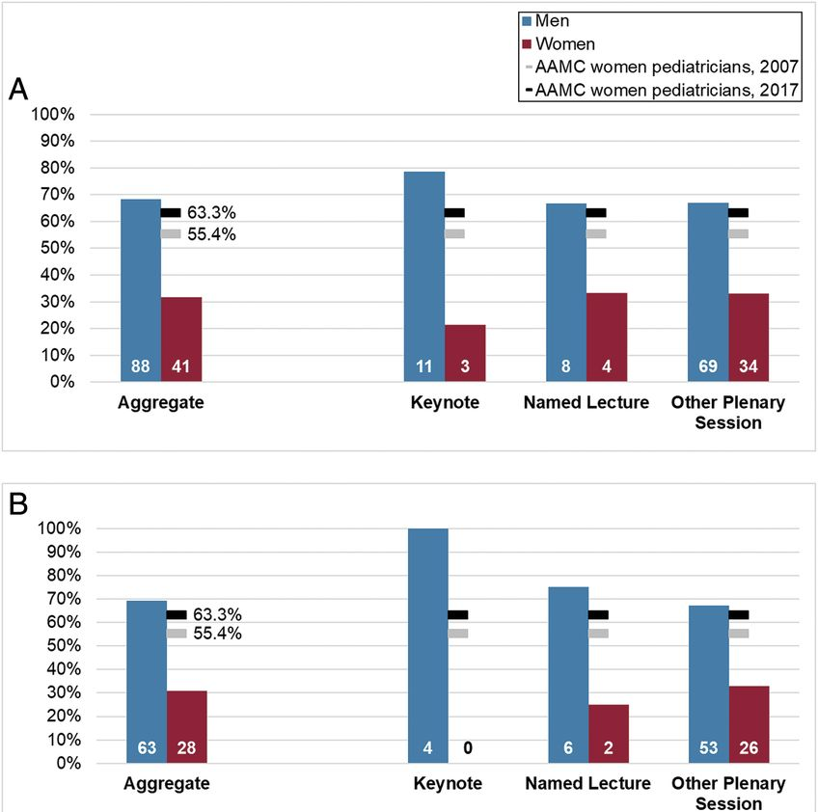
C Yong, S Balasubramanian, PS Douglas et al. Circulation. 2021; 143: 755
PEDIATRICS. 2019. 144 (5).
Women are underrepresented in all invited speaker roles at national conferences
No significant temporal changes

Slide 12
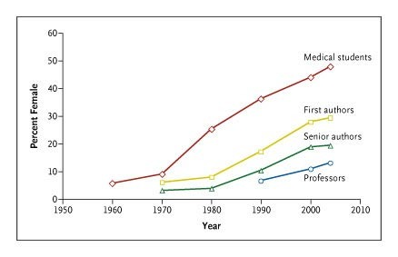
Authorship – overall trends of improvement
Notes:
Five major journals

Slide 13
Authorship – disparities persist in clinical trial representation
JAMA 2021; 4(3)
 |  | No. (%) of trials with female authors
Journal |  | First author | Last author
JAMA | 41 | 5 (12.2%) | 7 (17.1%)
The Lancet | 70 | 5 (7.1%) | 6 (8.6%)
NEJM | 89 | 8.5 (9.6%) | 7 (7.9%)
Total | 200 | 18.5 (9.3%) | 20 (10%)

Slide 14
Funding
First time principal investigators¹
  Women received ~ 39 K less than men in funding
  Big Ten universities, women received ~ 81K less than men
Among R01 renewals
  Scoring disparities between men and women applicants not explained by productivity / impact
  Differences in qualitative remarks
    Men (leaders, pioneers, highly innovative, highly significant research)
    Women (having expertise, working in excellent environments)
¹ Olivera et al., JAMA. 2019; 321 (9): 898.
² Magua et al., J Womens Health. 2017; 26 (5): 560.

Slide 15
Advancement
Journal of Women’s Health. May 2019
N Engl J Med 2020;383:2148-57
Notes:
A longitudinal study of 35 years. 24% less likely to be promoted to associate
23% less likely to be promoted to full professor
54% lower odds of being departmental chair
Sex differences did not diminish over time

Slide 16
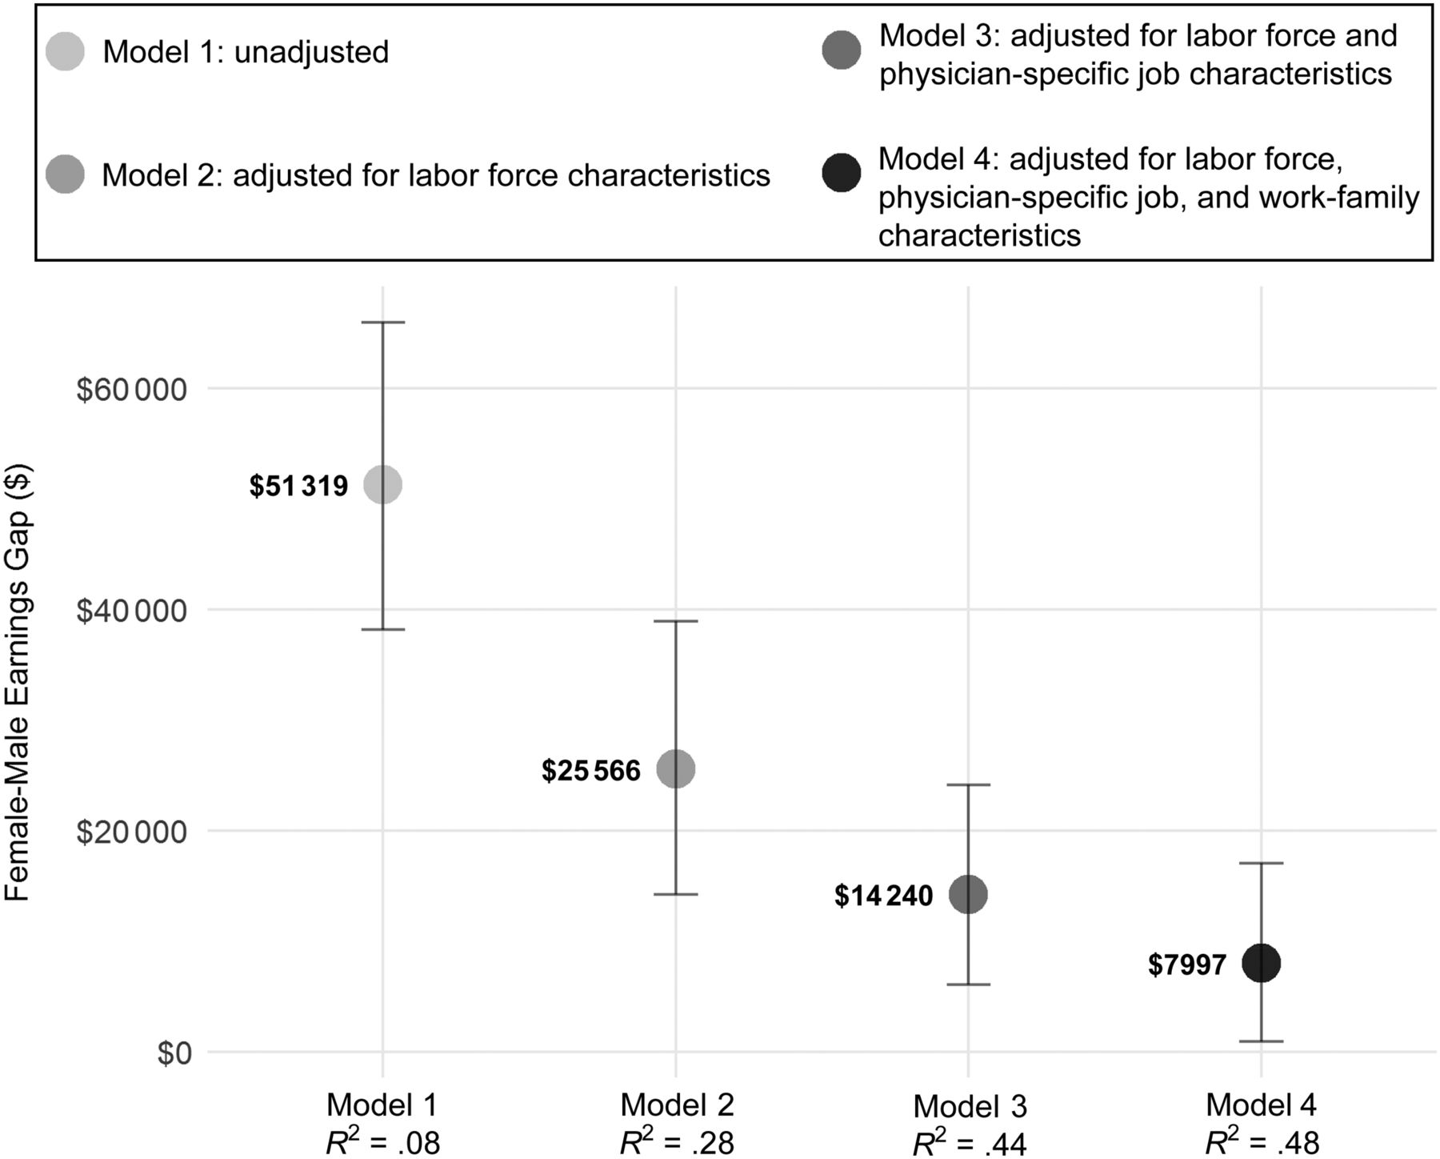
Earnings
PEDIATRICS. 2019; 144 (4).
Jagsi et al., JAMA. 2012;307(22):2410
Survey of 1729 physician researchers
Males were associated with a higher salary ($13 K) adjusting for multiple factors
Cumulative difference of ~$350K over a 30 year career
76%
87%
91%
94%

Slide 17
Respect and Status
Medical specialty societies
Women represent 25% on governing boards
Held 16% of elected leader positions
Women held 18.5% endowed chairs
Disparity persists after controlling for other factors
Due to breakdown in communication
Double standard – conform to gender over professional norms
Personal and professional implications
Notes:
Proportion of females receiving compensation were lower, median payment value was lower for consulting and honoraria

Slide 18
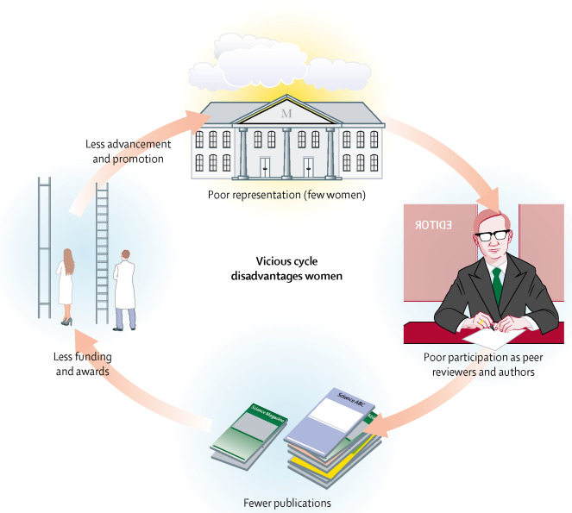
Vicious Cycle
Medical Journals
Societies
Universities
Hospitals
Funding Agencies
2021
Pubmed Articles
1989
Notes:
Particularly in fields where the apprentice identifies with the role models that they can relate to, greater presence of women in editorial boards will not only add to current diversity, but will groom future generations to strive for similar equity

Slide 19
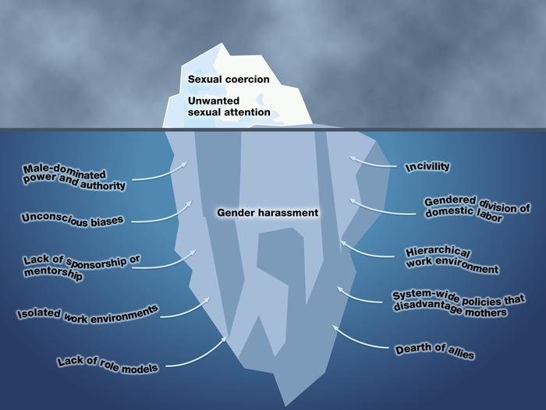
Causes of under-representation of women
Gendered Expectations
Meritocracy
Pipeline Justification
Sexual Harassment
Unconscious Bias
“other people are biased, not me”
“Fix the women”
…lean in, negotiate better, adopt powerful postures, talk more at meetings…

Slide 20
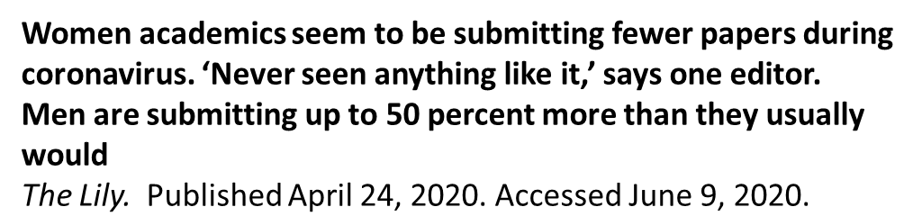
Effects of a Pandemic
Erin J. Madriago MD and Christina Ronai MD. JAMA Cardiology, July 2020
We are actively concealing that we are now required to perform many roles,
working harder than ever to straddle several environments while not
using leadership qualities that have been successful in the past. Instead,
we need to heed this warning.

Slide 21
Effects of a Pandemic
Reduction in manuscript submissions may be only one aspect in the spectrum of problems
  Conducting less research
  Participating / managing fewer clinical trials
  Engaging in fewer local regional or national committees / societies
Higher burden of domestic responsibilities (gendered expectations)
  Disproportionate impact on mothers with young children
  Challenges with telemedicine, educational talks, trainee conferences
Virtual meetings (early morning, late evening)
  Challenges with work / life boundaries

Slide 22

Causes, Effects, Solutions…
Publishing / Societies
Aggressive approach to incorporate diversity
  Editorial boards, invited speakers, panelists etc.
Explicit commitments by journal with measurable metrics and timeline
Institutions
Transparency and consistent criterion-based process for recruitment, promotions and compensation
Strong mentorship and sponsorship programs
Institutional programs for women advancement
Unconscious bias training
A Penn program with a mission to improve the recruitment, retention & advancement of women faculty + promote education & research in women’s health & leadership
The Lancet is committed to no all-male panels (“manels”) For events that we organize or plan, we aim for at least 50% female speakers.

Slide 23


Causes, Effects, Solutions…
Policies to improve work-life integration
Maternity / paternity leave
Childcare
Time banking
Reexamine strategies adopted during the pandemic
Trainees
Social Media
Support groups
Collaborations
Promotion of research

Slide 24
Institutional Efforts – Advance Program
https://advance.umich.edu/

Slide 25
Institutional Efforts – Advance Program
Future projects
Promotion process
Endowed chairs
Recruitment
Disparities in spousal recruitment
Interventions
  Mentorship
  Sponsorship
https://advance.umich.edu/

Slide 26
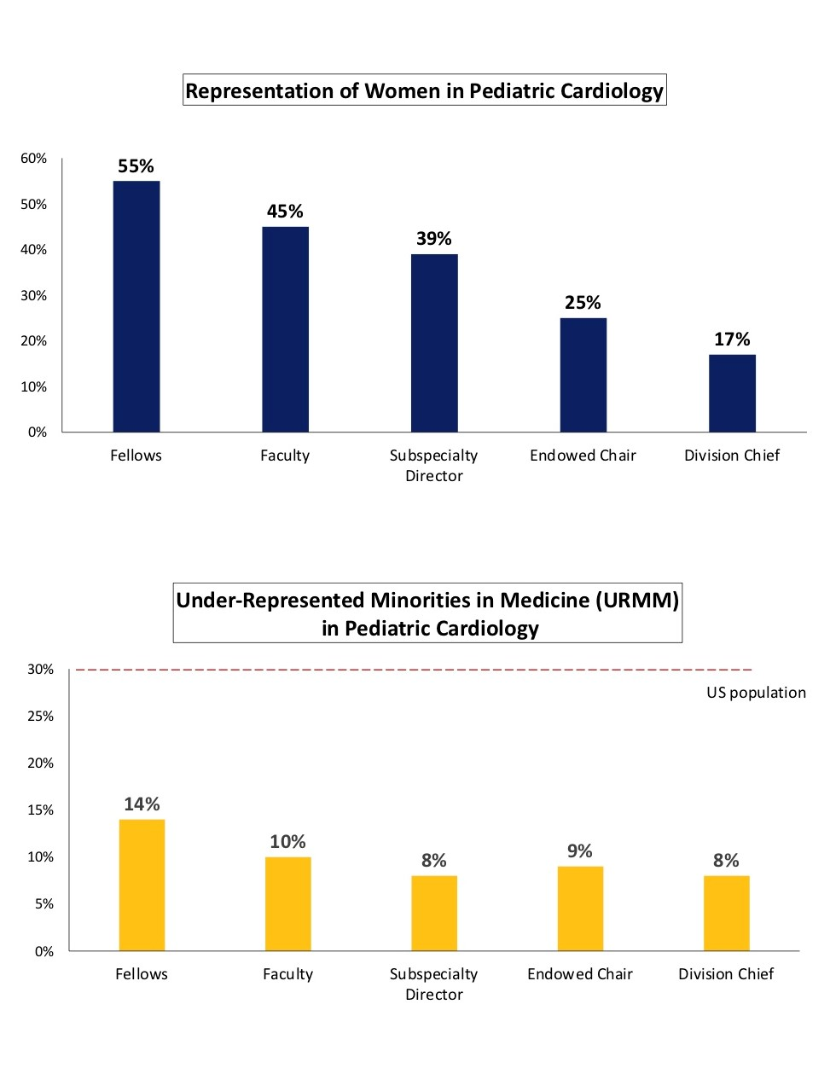
Institutional Efforts – Pediatric Cardiology
Representation of Women in Pediatric Cardiology
National landscape in pediatric cardiology
Survey of US academic pediatric cardiology programs
  Completed survey represents 1575 faculty and 438 fellows
  “Leaky pipeline” for women in pediatric cardiology and limited presence of URRM overall
  Next steps – focus groups with national representation
URM in Medicine in Pediatric Cardiology

Slide 27
Institutional Efforts – Congenital Heart Surgery

Slide 28
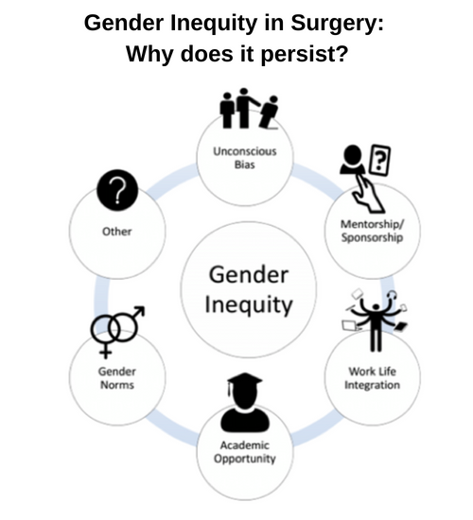
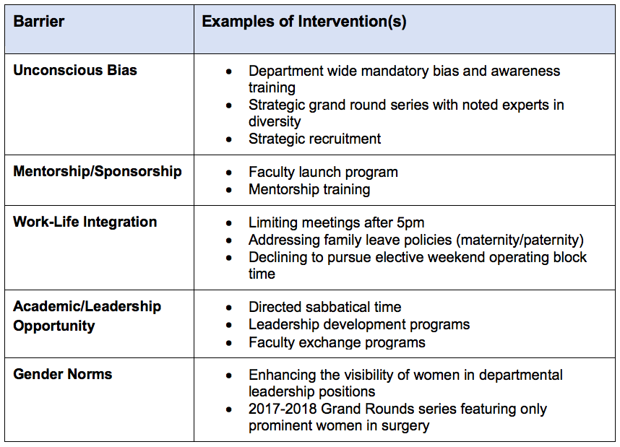
Institutional Efforts – General Surgery
https://medicine.umich.edu/dept/surgery/faculty-resident-life/our-initiatives

Slide 29
Discussion
Gendered Expectation
Gender Disparities
Publishing
Funding
Medical Societies
Academic Institutions
Unconscious Bias
Gender Harassment
Meritocracy

Slide 30
Acknowledgments
Division of Pediatric Cardiology
Leadership
Caren Goldberg, Sara Pasquali, Melissa Cousino, Sonal Owens, Carlen Fifer, Caroline West
Department of Radiology
Prachi Agarwal
Aparna Joshi
Department of Cardiovascular Medicine
Claire Duvernoy, Sara Saberi, Sharlene Day
Stanford Medical School
Celina Yong
Funding
Elizabeth Caroline Crosby Research Grant

Slide 31
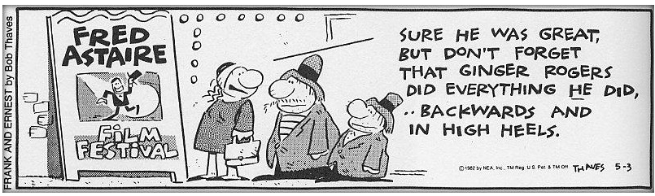
Questions
Notes:
This inclusion of women at early stages of their academic career is a healthy sign of a promising future, and in turn gives them a chance to lead and mentor future generations.

Slide 32
“In the future, there will be no female leaders. There will just be leaders.” — Sheryl Sandberg
Summary
Crucial time for change
Gender balance in academic medicine benefits everyone
Data informs and paves avenues for action
  No one universal solution – emphasis on systematic, stage appropriate interventions
Example of the pandemic (a temporary crisis) – reveals beneath the surface disparities that a likely long standing
Concrete measures, explicitly stated commitments – actionable items
Notes:
This inclusion of women at early stages of their academic career is a healthy sign of a promising future, and in turn gives them a chance to lead and mentor future generations.

