Slide 1
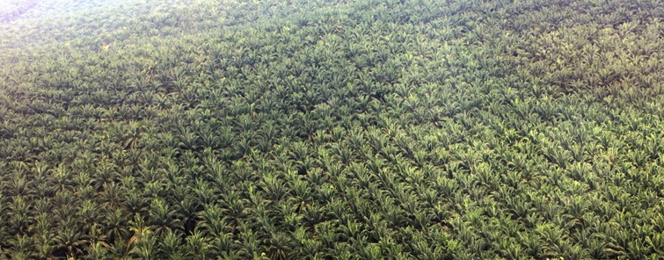
Social and Environmental Justice Issues
and Human Health
Francine Dolins, Ph.D., Daniel Arini, Anthony Cieri, Harry Rahn
University of Michigan-Dearborn
Palm Oil Plantations and Their Impact
http://www.saynotopalmoil.com/images/postImages/postImage1394171325.jpg

Slide 2
Palm Oil Plantations: Illegal Activities
Governments, corporations, and other organizations at various scales have promoted palm oil cultivation such that the deforestation which results from it is institutionally viewed as a necessary cost of development and poverty relief (Susanti and Maryudi 2016, 130).
Bribed government officials in developing countries have permitted foreign palm oil investors to illegally cut down protected forests (Pachmann 2018, 59).

Slide 3
The Investment of the University of Michigan Endowment in Palm Oil Plantations, Democratic Republic of Congo
Background: (from details provided by the Oakland Institute) Without consent from local communities, the Belgian colonial government and then the Democratic Republic of Congolese government licensed the British industrialist Lord Leverhulme to create vast oil palm plantations for his company, Plantations et Huileries du Congo (PHC). These free concessions turned into plantations helped fuel the rise of the Lever Brothers and laid the foundation for today’s corporate giant, Unilever.
The 100,000 hectares (approx. 386 sq. miles) of oil palm plantation concessions passed from Unilever to Feronia in 2009. Despite receiving over US $150 million in financing from European development banks since 2013, Feronia filed for bankruptcy in 2020 only 7 years later. The development banks agreed to pass the assets they held in PHC to a consortium led by Kuramo Capital Management (KCM), for a cash payment of US$500,000 and agreed to write off large portions of remaining debt. The deal was conditional on the new owners investing US$10 million in PHC and implementing a revised environmental and social action plan. Before the KCM consortium became majority owners in November of 2020, they previously held a minority share dating back to 2017.
The University of Michigan is presently the largest publicly known investor into funds controlled by Kuramo Capital Management (KCM). Dating back to 2011, UM has invested a total of US $125 million into various Kuramo Capital Management funds (see Table 1 next slide).

Slide 4
Table 1. University of Michigan Investments into funds controlled by Kuramo Capital Management
Fund | Amount (US $)
Kuramo Africa Opportunity Fund - July 2011^{[i]} | 15 million
Kuramo Africa Opportunity Fund II & Kuramo Africa Opportunity Co-Investment Vehicle II - April 2015^{[ii]} | 50 million
Kuramo Africa Opportunity Fund II & Kuramo Africa Opportunity Co-Investment Vehicle II - January 2017^{[iii]} | 10 million
Kuramo Africa Opportunity Fund III & Kuramo Africa Opportunity Co-Investment Vehicle III - July 2018^{[iv]} | 50 million
Total | US $125 million

Slide 5
Under Kuramo Capital Management - Communities Remain Deprived, Documented Human Rights Abuses Remain Unabated
Investment of the University of Michigan Endowment in Palm Oil Plantations, DRC
Under Kuramo Capital Management (KCM), communities remained deprived of their land and subjected to human rights abuses.
Numerous reports have documented the human and environmental abuses that were inflicted on local villagers, including: unpaid wages; exposure to dangerous pesticides; the routine dumping of untreated industrial waste contaminating a major supply of local drinking water; denial of compensation for injuries on the job; and illegal arrests, beatings, and killings of villagers^{[i]}.
The dispossession from villager’s ancestral land has crippled livelihoods, as poverty and hunger has become widespread.
^{[i]} Reseau D’Information et D’Appui Aux ONG Nationales- RDC RIAO-RDC. Maître Dominique LUMPEMPE KANGAMINA, Avocat au Barreau de la Tshopo et Activiste des Droits Humains. Septembre, 2021. Available at: https://www.oaklandinstitute.org/riao-drc-report-human-rights-situation-lokutu-and-bolombo.

Slide 6
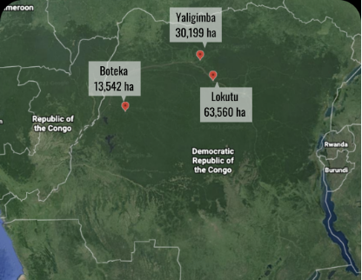
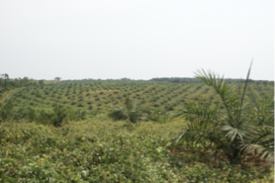
Map of the Oil Palm Plantations: Democratic Republic of Congo
Oil Palm Plantation in the DRC

Slide 7
Under Kuramo Capital Management - Documented Human Rights Abuses Cont.
Investment of the University of Michigan Endowment in Palm Oil Plantations, DRC
Under Kuramo Capital Management (KCM), communities are subjected to continued human rights abuses.
Plantation security guards have been responsible for arrests, beatings, and for killings of villagers, including Blaise Mokwe and Efolafola Nisoni Manu who were reportedly killed in February 2021.
An independent investigation carried out in September 2021 revealed how the violence perpetrated against community members continues unabated. On September 14, 2021 DRC soldiers and industrial guards from PHC reportedly destroyed dozens of homes, “committed systematic looting in several villages, including torture and kidnapping of civilians from communities surrounding the plantations.”^{[i]}
PHC security forces have specifically targeted local activists who have opposed the company’s abuses.^{[i]} On September 15, 2021, Franck Balimbasa, a human rights defender working with the local organization RIAO-RDC, was arrested and kept in jail for weeks without charge.
Another community member named Jean Bofanda Banga was also arrested and reportedly severely beaten while in captivity.^{[i]}
^{[i]} Reseau D’Information et D’Appui Aux ONG Nationales- RDC RIAO-RDC. Maître Dominique LUMPEMPE KANGAMINA, Avocat au Barreau de la Tshopo et Activiste des Droits Humains. Septembre, 2021. Available at: https://www.oaklandinstitute.org/riao-drc-report-human-rights-situation-lokutu-and-bolombo.
^{[i]} Ibid.

Slide 8
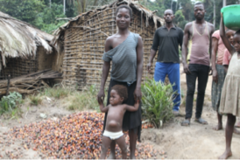
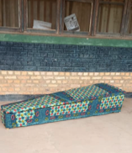
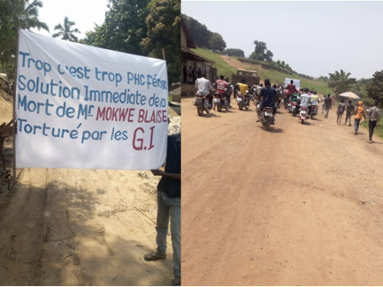
Documented Human Rights Abuses by KCM
Community members of Mwingi near the disputed land of the Lokutu concession © Oskar Epelde.
February 2021, protest march after the death
of Blaise Mokwe
February 2021, the body of Blaise Mokwe, a community member who died at the hands of plantation security guard was placed outside the PHC office in protest following his funeral.

Slide 9
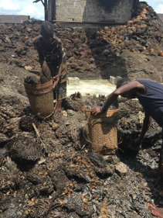
Documented Human Rights Abuses by KCM continued
Women workers collecting palm fruit waste without protective equipment in the PHC Boteka oil palm mill © 2018 Luciana Téllez/Human Rights Watch.
References:
^{[1]} Reseau D’Information et D’Appui Aux ONG Nationales- RDC RIAO-RDC. Maître Dominique LUMPEMPE KANGAMINA, Avocat au Barreau de la Tshopo et Activiste des Droits Humains. Septembre, 2021. Available at: https://www.oaklandinstitute.org/riao-drc-report-human-rights-situation-lokutu-and-bolombo.
^{[2]} Ibid.
^{[3]} According to the mission report, PHC has established a database to register and track community members who speak out against land and labor injustices perpetrated by the company. Ibid.
^{[4]} Ibid.
^{[5]} Slottow, T. P. (2011). Approval of Alternative Asset Commitment. The University of Michigan Regents Communication. https://regents.umich.edu/files/meetings/07-11/2011-07-IX-3.pdf
[6] Hegarty, K. P. (2015). Alternative Asset Commitments. University of Michigan Regents Communication. https://regents.umich.edu/files/meetings/06-15/2015-06-IX-2.pdf
^{[7]} Hegarty, K. P. (2017). Alternative and Absolute Return Commitments. University of Michigan Regents Communication. https://regents.umich.edu/files/meetings/04-17/2017-04-IX-2.pdf
^{[8]} Hegarty, K. P. (2019). Alternative Commitments. University of Michigan Regents Communication. https://regents.umich.edu/files/meetings/02-19/2019-02-IX-1.pdf

Slide 10
Palm Oil Plantations: Social Injustices - Health and Treatment of Workers
Child labor is utilized to help parents meet daily quotas. This results in children dropping out of school. These children take on the debts of their parents.
Workers are being exploited to produce increasing yields of palm oil. The workers can develop negative health impacts from exposure to pesticides and herbicides. They are often in debt bondage, make below minimum wage (under $2.50/day in USD), and cannot fight for better work conditions/wages.
(Goldman Environmental Foundation, 2016)

Slide 11
What is palm oil in?
Palm oil is all around us in daily life, but where exactly? Guess and the answers may surprise you.
Is palm oil necessary in any of these products?
NO!
It can easily be replaced by locally grown oil products, such as canola, corn, safflower oils, etc.
Many processed foods?
What about cleaning products?
Yes, all of the above!
To continue learning why this is a problem, read on
Even cosmetics?
Pet food of all things?
(Meijaard et al. 2018)

Slide 12
Palm Oil: Human Health
(U.S. National Library of Medicine, n.d.)
Made of around 50% saturated fatty acids or bad cholesterol, over-ripe palm fruits contain even higher saturated fatty acids.
Bad Cholesterol
Sticks to the walls of arteries and veins.
High palm oil consumption can make you more susceptible to health problems. These include by causing an increased risk of developing high cholesterol, and being a leading factor in cardiovascular diseases like arteriosclerosis, heart attack, stroke, or even heart failure.

Slide 13
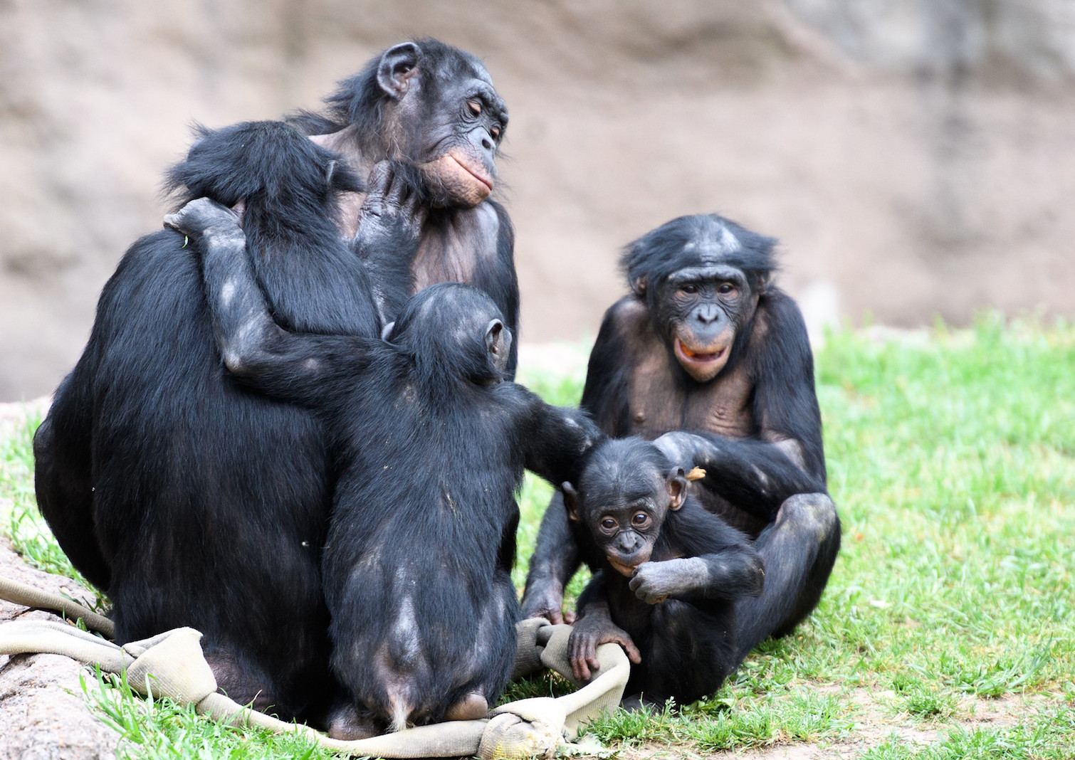
A Species in Jeopardy: the Bonobo
“Bonobos (Pan paniscus), or pygmy chimpanzees, are [...] our closest living [primate] relatives. They are found only in the Democratic Republic of Congo (sic), where estimates from their four remaining strongholds suggest that no more than 10,000 to 20,000 individuals remain; the exact number is unknown because only about of third of the species’ historic range has been surveyed. Although they are classified as endangered by the IUCN, most of their habitat is unprotected and under threat of being destroyed by deforestation.” (Mongabay, 2020)
Personal Note: Francine Dolins has two Templeton Foundation grants to study the rare, captive bonobos whose intelligence and social abilities are extraordinary amongst primates.
https://news.mongabay.com/2020/04/images-from-a-dropped-phone-reveal-the-ugly-truth-behind-bonobo-trafficking/

Slide 14
Palm Oil Fields: Deforestation
...Then comes the burn
Palm oil plantations are replacing large areas of natural forests in Southeast Asia, Africa and South America. This is the primary driver of deforestation.
Forest ecosystems conserve biodiversity, help with water filtration, carbon storage and manages pests.
First comes the slash...
What you just witnessed is a rendition of the deforestation method called slash and burn, a technique used to make way for oil palm plantations (BBC, 2019). By clearing rainforests, virtually all of the flora and fauna species which reside in them - such as rare and endangered orchids, bonobos, chimpanzees, orangutans, gibbons, monkeys, parrots, woodpeckers, multiple amphibians, as well as many other small mammals and pollinating insects - are put in jeopardy (Dhandapani, 2014).

Slide 15
International attention to the deforestation in the DRC: the second biggest rainforest will soon reopen to large-scale logging
Link to National Geographic Article
National Geographic article on the environment - second biggest rainforest will soon reopen to large scale logging

Slide 16
Promoting Sustainability through the University of Michigan: local is global, and global is local
LOCAL
GLOBAL
University of Michigan-Ann Arbor
The Democratic Republic of Congo
University of Michigan-Dearborn
Indonesia - Borneo, Java, etc.
University of Michigan-Flint
The Philippines
Brazil
Peru

Slide 17
Conclusions: What can the University of Michigan do to Fulfill its Social and Environmental Justice Missions?
Divest from all industries involved in generating forest extractive products. For example: palm oil, bauxite mining (involved in producing aluminum), and soy and cattle farms in tropical regions.
Educate the public on the health impacts of palm oil on consumers.
Bring public awareness to the unethical treatment of local communities, farmers and their families. Make people aware of the deforestation and its impact on human health, wildlife and the ecosystem.
Reduce and replace products known to contain palm oil and palm derivatives in foods in our diets, beauty products, and household cleaners.
Collaborate with institutions to advise them on palm oil free alternatives.

Slide 18
References
BBC, British Broadcast Corporation. 2019. “Indonesia haze: Why do forests keep burning?” BBC. https://www.bbc.com/news/world-asia-34265922
Bentivoglio, Deborah, Adele Finco, and Giorgia Bucci. "Factors Affecting the Indonesian Palm Oil Market in Food and Fuel Industry: Evidence from a Time Series Analysis." International Journal of Energy Economics and Policy 8.5 (2018): 49-57. ProQuest. Web. 20 Aug. 2021.
Dhandapani, S. (2014). “Biodiversity Loss Associated with Oil Palm Plantations in Malaysia: Serving the Need versus Saving the Nature.” Master’s thesis, Lancaster University. https://www.researchgate.net/publication/281523357_Biodiversity_loss_asoociated_with_oil_palm_plantations_in_Malaysia_Serving_the_need_versus_Saving_the_nature
Meijaard, E., Garcia-Ulloa, J., Sheil, D., Wich, S.A., Carlson, K.M., Juffe-Bignoli, D., and Brooks, T.M. (eds.) 2018. Oil palm and biodiversity. A situation analysis by the IUCN Oil Palm Task Force. IUCN Oil Palm Task Force Gland, Switzerland: IUCN. doi: 10.2305/IUCN.CH.2018.11.en.
Montoya, C., Cochard, B., Flori, A., Cros, D., Lopes, R., Cuellar, T., Espeout, S., Syaputra, I., Villeneuve, P., Pina, M., Ritter, E., Leroy, T., & Billotte, N. (2014, May 9). Genetic architecture of palm oil fatty acid composition in Cultivated oil palm (Elaeis Guineensis JACQ.) compared to its wild relative e. OLEIFERA (H.B.K) CORTÉS. PloS one. https://www.ncbi.nlm.nih.gov/pmc/articles/PMC4015976/.
Pachmann, Ales. 2018. "Corruption and Deforestation in Indonesia." Regional Formation and Development Studies 25(2): 57-64. doi:10.15181/rfds.v25i2.1745.

Slide 19
References continued
Palm oil: Global brands profiting from child and forced labour. Amnesty International. (2021, August 16). https://www.amnesty.org/en/latest/news/2016/11/palm-oil-global-brands-profiting-from-child-and-forced-labour/.
Susanti, Ari and Ahmad Maryudi. 2016. "Development Narratives, Notions of Forest Crisis, and Boom of Oil Palm Plantations in Indonesia." Forest Policy and Economics 73(2016):130-139. doi: 10.1016/j.forpol.2016.09.009.
The dirty business of producing palm oil: climate change, toxic waste and child labor. Goldman Environmental Foundation. (2016, April 28). https://www.goldmanprize.org/blog/dirty-business-producing-palm-oil-climate-change-toxic-waste-and-child-labor/.
U.S. National Library of Medicine. (n.d.). Facts about SATURATED FATS: Medlineplus medical encyclopedia. MedlinePlus. https://medlineplus.gov/ency/patientinstructions/000838.htm.

