Slide 1
Culture Change: Values Identification

Slide 2
Harmful Events
Wilmer-Hale Report – “…over the course of more than fifteen years, Philbert engaged in sexually harassing behavior….”
Dr. Anderson Lawsuit – University's 240-page report, commissioned and paid for by UM, concluded Anderson sexually abused patients, 90% of whom were men, on "countless occasions."
Michigan Daily – “Former students bring 40 years of misconduct allegations against SMTD professor [Stephen Shipps]”
Notes:
We know there are many other events that have taken place...over many years.
These events, however, were very public...and do not represent who we aspire to be.
We need to heal.

Slide 3
Aspiration & Challenges
We deeply aspire to be an inclusive environment where everyone feels valued and each individual can see a connection to the University mission: to make this a better world through education and research.
Challenges:
Lack of accountability
Lack of trust
Fear of retaliation
Notes:
(from Pres. Schlissel, EE feedback, SMEs on campus; stakeholder meetings….)
We need to heal.
Challenges: What we are hearing and experiencing…
Lack of trust …of leadership, and each other
Lack of accountability…we don’t own our successes AND our failures…as an institution, as individuals
There is documented ‘fear of retaliation;
And we hear that many individuals still do not feel a ‘part of the University’…

Slide 4
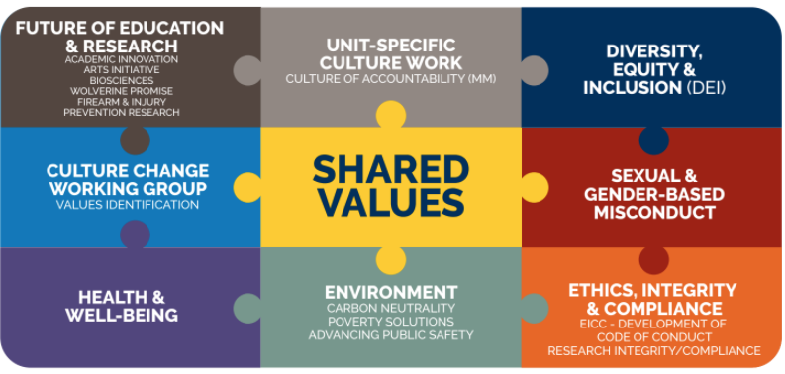
UM Culture Change Initiatives
Notes:
Culture Change has been going on… with many different initiatives.
Our work group…our effort is just one piece of that puzzle.

Slide 5
Values are Foundational
Establishing shared values is the first step to unify our community and build a culture that fosters trust and provides a strong foundation to live up to our highest ideals.
Shared values will communicate our core beliefs as a University community and prioritize the principles of care, support, education and prevention across our institution.
Notes:
Our institutional values have been assumed…but never stated intentionally.
Our values communicate ‘who we are’ and ‘what others can expect and feel when on our campus.’

Slide 6
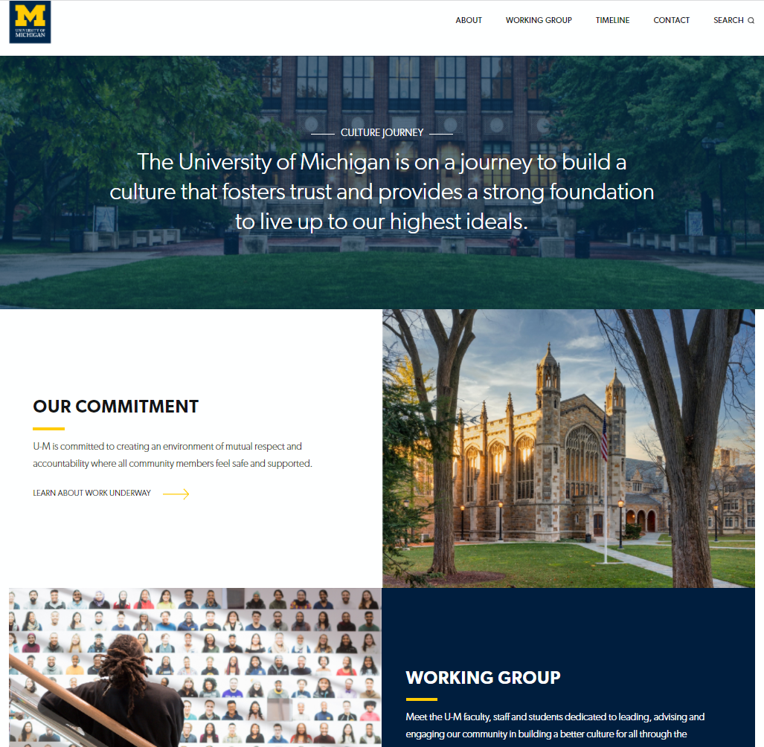
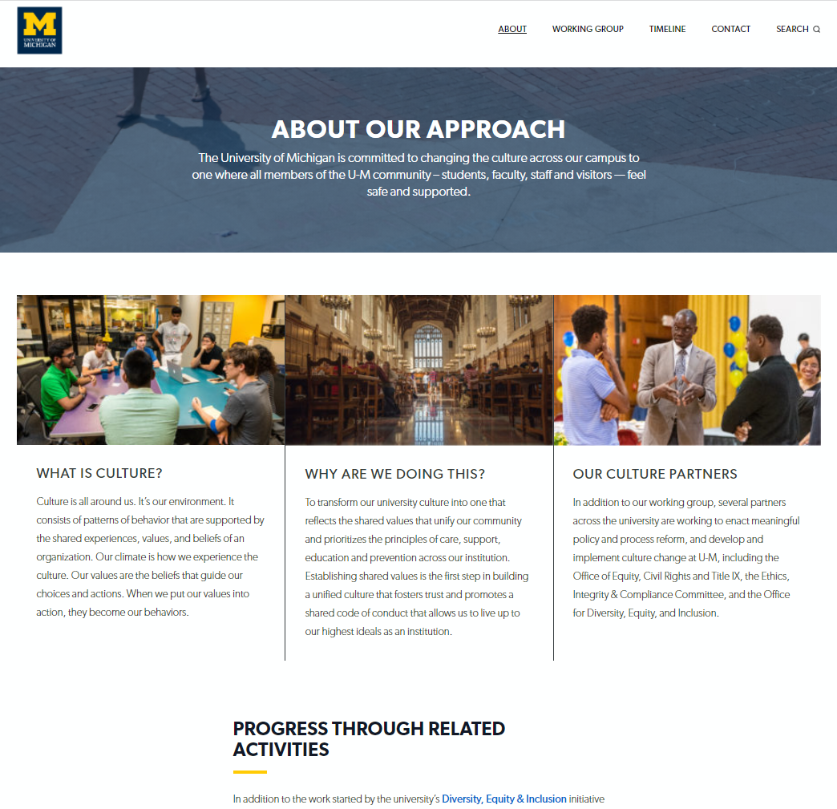
https://culturejourney.umich.edu/
Notes:
https://culturejourney.umich.edu/

Slide 7
PHASE 1: Assess Current State & Plan
(May 2021 - October 2021)
Convene Working Group
Plan and assess per objectives of working group charge
Visualize and describe the network of existing university-wide values
Objective 1
Notes:
SONYA
Visualize and describe the network of university-wide values that reflect its sum of the parts of the University of Michigan.

Slide 8
Process Summary - Institute of Social Research
Purpose:
Investigate the values espoused by different units.
Create a series of visualizations illustrating the relatively common conceptual elements in the various value statements
Collection:
Solicited value statements from a variety of units across the University.
27 schools, colleges, and other units responded
23 sent statements, in different forms and formats
Analysis:
The words and frequencies were used to generate word clouds and other visuals using WordClouds.com, WordArt.com, and Canva.
1. Bird, Steven, Edward Loper and Ewan Klein (2009), Natural Language Processing with Python. O’Reilly Media Inc.
Notes:
Collection:
The documents were collected in two solicitations at the request of Patricia Hurn, Dean of the School of Nursing, and Sonya Jacobs, Chief Organizational Learning Officer at the University. Of the 27 schools, colleges, and other units that responded to the solicitations, 23 sent statements.
The database consisted of documents reflecting value statements from a variety of units across the University. The documents were collected in two solicitations at the request of Patricia Hurn, Dean of the School of Nursing, and Sonya Jacobs, Chief Organizational Learning Officer at the University. Of the 27 schools, colleges, and other units that responded to the solicitations, 23 sent statements. The documents arrived in different forms and formats. As a first step, sections on Mission or Vision were eliminated. Most of the documents (19) contained a “Values” statement. For each document, keywords were initially defined by the unit’s use of bold text or section headers there.
Analysis:
The analysis was conducted by the team of Jenny Ney, a MADS student from the School of Information, and Michael Traugott, Research Professor Emeritus in the center for Political Studies at ISR,.
Keywords were analyzed in Python through tokenization and stemming from the nltk library¹. Using lists of unique stems from each set of keywords, a frequency count of each term was calculated across all statements. Only shared terms occurring in more than one document were put into visualizations. The stems were then reverted to a common noun form for this use.

Slide 9
Distribution of Top Keywords
Visualizations of Top Keywords
Notes:
Inclusion appears most frequently as a keyword (18 statements). Service, Transparency, and Respect are tied in frequency (5 statements each).

Slide 10
Word Clouds Can Portray Different Aspects of Values Represented in the Statements
All keywords show the range of values
Common keywords appearing in at least two statements

Slide 11
PHASE 2: Gather & Analyze Evidence (October 2021 – April 2022)
Engage U-M community at large to inform on process, methodology and foundational values, and solicit feedback through information sessions and Town Halls
Gather and analyze evidence demonstrating the gap between U-M’s stated values and lived experience through survey results, focus groups, and interviews
Objectives 2 & 3
Notes:
SONYA
Assemble and analyze the evidence that unspoken, non-transparent values are present and at work in our communities. Address the potential for mismatch with our public values statements.
Engage community at large to provide feedback on a network of values, and better understand what factors prevent community members from feeling safe, and the disconnect between stated values and the lived experience.

Slide 12
Engagement opportunities:
Information Sessions
Town Halls
Focus Groups
Notes:
SONYA
Info Sessions: key stakeholders
Town Halls: all
Focus Groups: dig deeper

Slide 13
PHASE 3: Recommendations (April 2022 – May 2022)
Prepare and submit recommendations per working group objectives to president and executive officers
Objectives 4
Notes:
Possible Future Work
Socialize and adopt unifying shared values
Develop value statements that will be foundational to a shared code of conduct
Phase 4: Announce and Implement our Shared Core Values (May 2022 – May 2023)
Evaluation to start January 2023
Phase 5: Evaluate and Sustain (January 2023– May 2023)

Slide 14
Questions and Feedback
Notes:
PATTI

